Slide 1

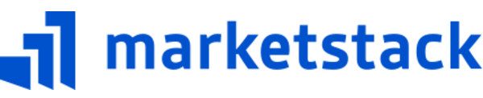
Group
Presented by:
First Name | Last Name | Student No.
Chakshu | Madan | N01649164

Slide 2
Agenda
1. What is Marketstack?
2. Fetching data - Apple, Google, Microsoft
3. Analysis:
3.1 Trend of Stock Prices - Apple, Google, Microsoft
3.2 Trend of Trading Volume - Apple, Google, Microsoft
3.3 Highest / Lowest Price in 2024 - Apple, Google, Microsoft
3.4 Price Prediction - Apple, Google, Microsoft

Slide 3

What is Marketstack?
- Marketstack is a financial market data API that provides real-time, intraday, and historical stock market data.
- Marketstack offers API of a stock market data solution for both developers and companies.
- Marketstack API support more than 170,000 stock tickers from more than 70 global stock markets

Slide 4
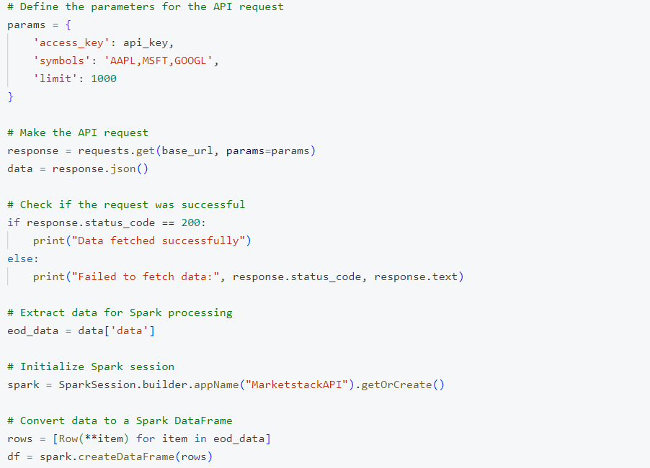
Fetching data

Slide 5
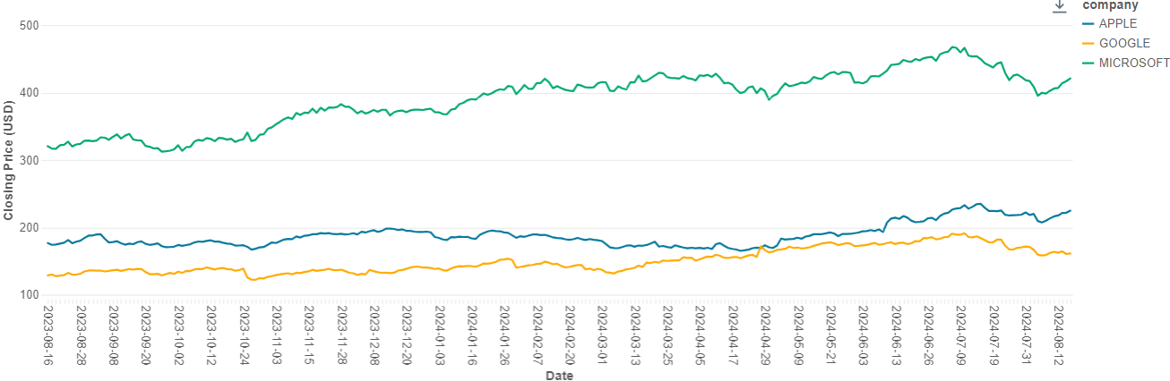
Trend of Stock Prices - Apple, Google, Microsoft
Stock Prices
2024
Note: 1) Data as of 16 August 2024.
2) Data from 16 August 2023 to 16 August 2024 (last 365 days)
Insight
Over time, all companies have shown positive price movement, reflecting overall market growth. Notably, Microsoft’s stock price has consistently been higher compared to Apple and Google, indicating higher valuation.

Slide 6
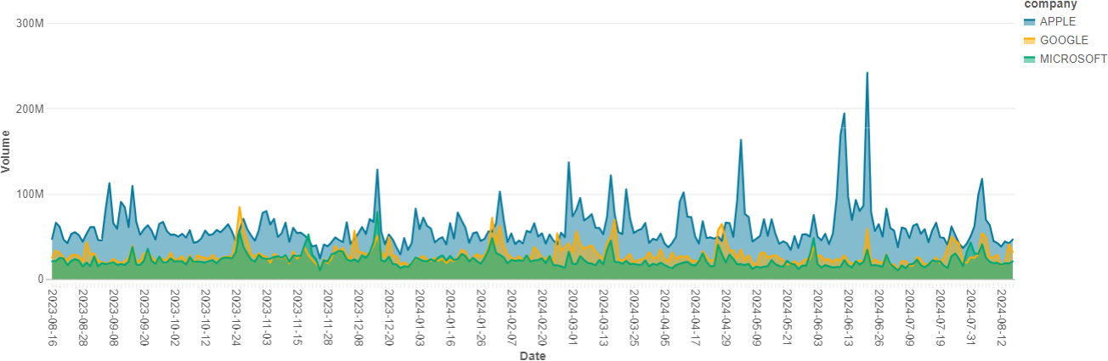
Trend of Trading Volume - Apple, Google, Microsoft
Trading Volume
2024
Note: 1) Data as of 16 August 2024.
2) Data from 16 August 2023 to 16 August 2024 (last 365 days)
Insight
Trading volume trends show that while all companies have experienced growth, Apple's trading volume has notably surged compared to Microsoft and Google.

Slide 7
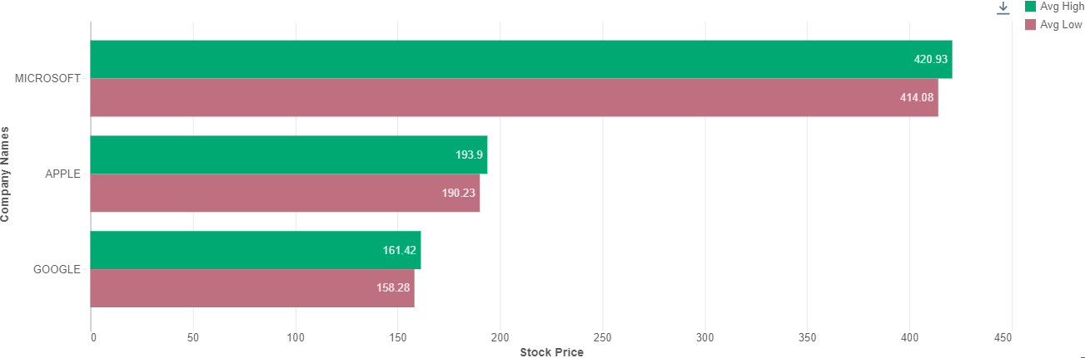
Highest / Lowest Price in 2024 - Apple, Google, Microsoft
Highest / Lowest Price in 2024
Note: 1) Data as of 16 August 2024.
2) Data from 1 January 2024 to 16 August 2024 (YTD)
Insight
Microsoft's average high and low stock prices are significantly higher than Apple and Google.

Slide 8
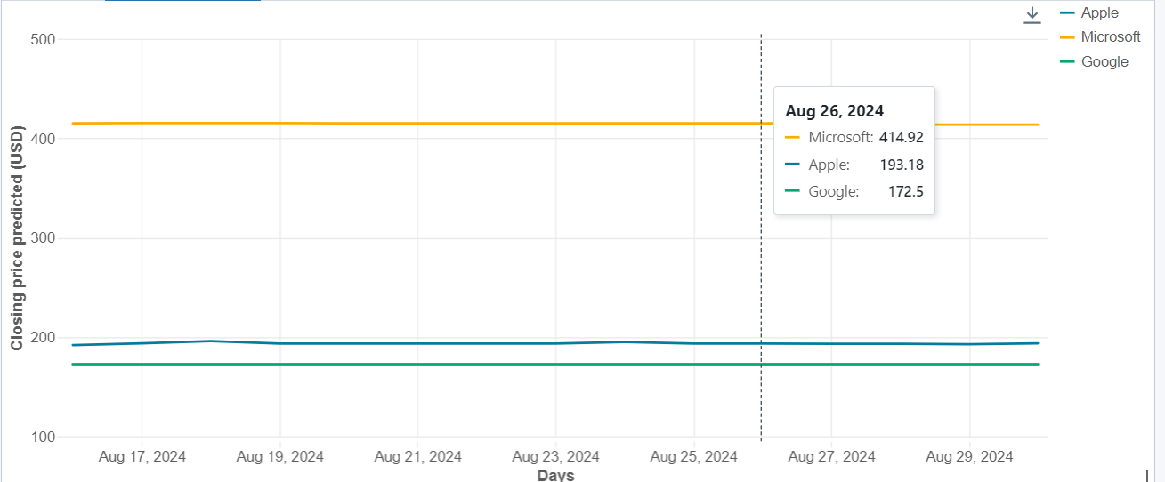
Price Prediction - Apple, Google, Microsoft
Price Prediction
Note: 1) Stock Price Prediction from 16 Aug to 30 Aug
Insight
Over the next 15 days, the stock prices of three major companies—Microsoft, Apple, and Google—remained relatively stable with minimal fluctuation.. Microsoft consistently maintained the highest stock price among the trio, followed by Apple, and then Google, reflecting its strong market position and investor confidence. This gradual rise at the end of the month suggests a steady market performance for these tech giants and bolsters investor prospects, reinforcing the attractiveness of these stocks for long-term growth.
Notes:
We applied 2 types of forecasting models which are decision tree regressor and pmdarima to predict the next 15 days which is from Aug 16 to Aug 30 of stock values of 3 companies .With accuracy 70%
the stock prices of three major companies remained relatively stable with minimal fluctuation. Microsoft consistently maintained the highest stock price among the trio, followed by Apple, and then Google, reflecting its strong market position and investor confidence

Slide 9
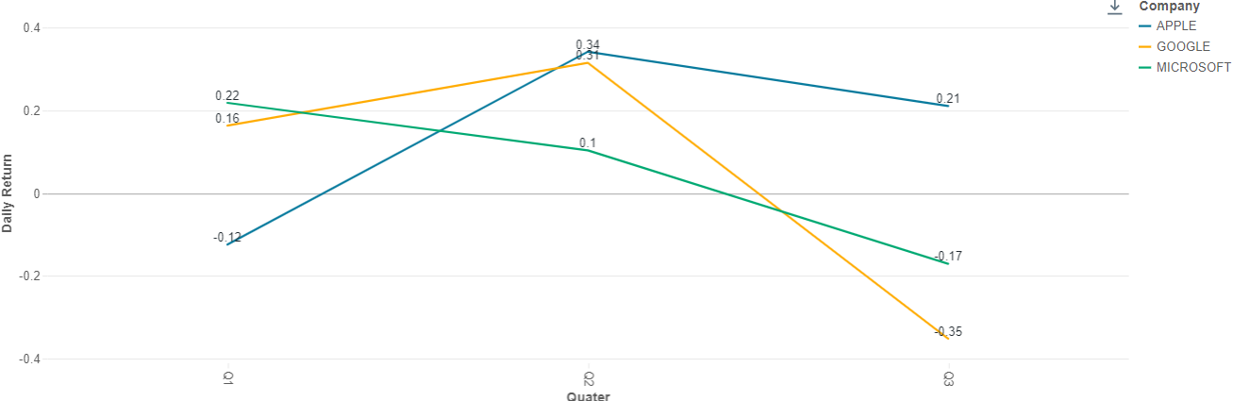
Daily Stock returns in 2024 - Apple, Google, Microsoft
Daily Stock Returns
Note: 1) Data as of 16 August 2024.
2) Data from 1 January 2024 to 16 August 2024 (YTD)
Insight
- Return trend of Microsoft declined from Q1 to Q3, even though Microsoft was the best performer in Q1 among the three companies. - Apple and Google, displayed the highest return in Q2 and followed the downward trend in Q3.

Slide 10
Thank You

